Slide 1
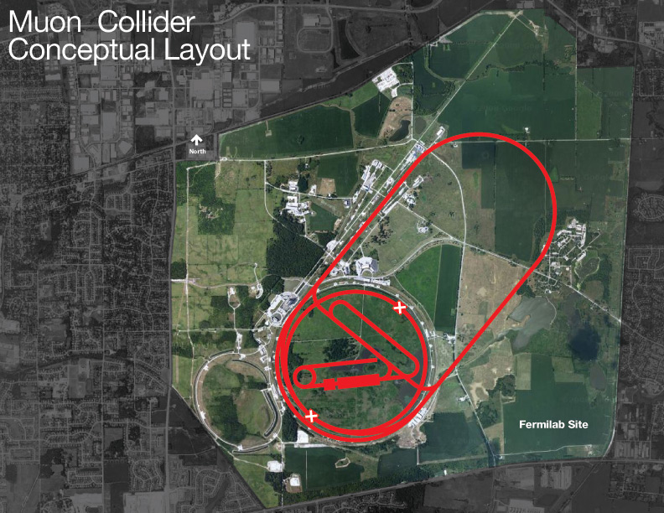
Background: Muon Accelerator Program
Concept for a particle accelerator that collides muons, rather than protons or electrons
Muons have several advantages that make them attractive for collider experiments
Elementary particle (as opposed to protons)
Large mass (relative to electrons)
Difficulty: Muons are unstable, must be collected from collision products

Slide 2
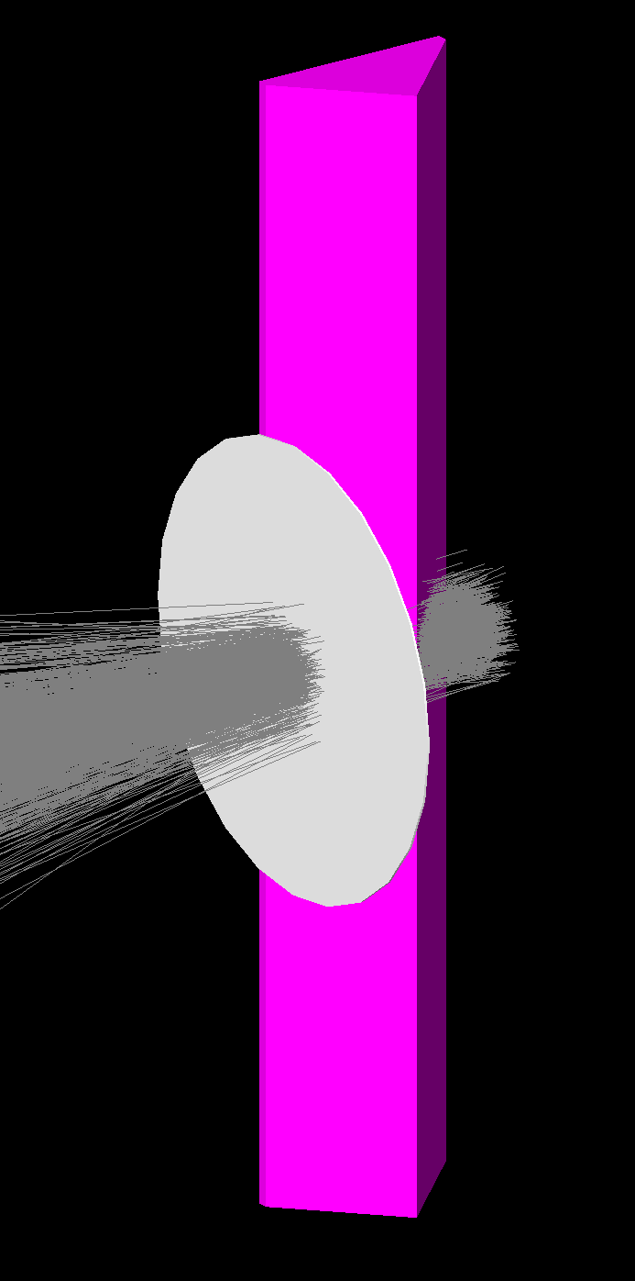
Muon Cooling
When produced, muons have a large initial spread of position and momentum (high emittance)
“Cooling” is the process of reducing spread in position and momentum of a particle beam
Multiple cooling methods exist
My project is to examine a method for final 4D cooling of the muon beam
Using simulation tool G4Beamline
Determine maximum performance and ideal starting point

